Slide 1

Development of an AR Air Hockey Game
Yassin Aden, Pau Francino, Boris Llona and Roger Weber

Slide 2
Agenda
The Idea
The Explanation
The Outcome

Slide 3
The IdEA
Braintorming & Evaluating
Creativity, Makebility & Effort
Decision: 2 Player Air Hockey

Slide 4
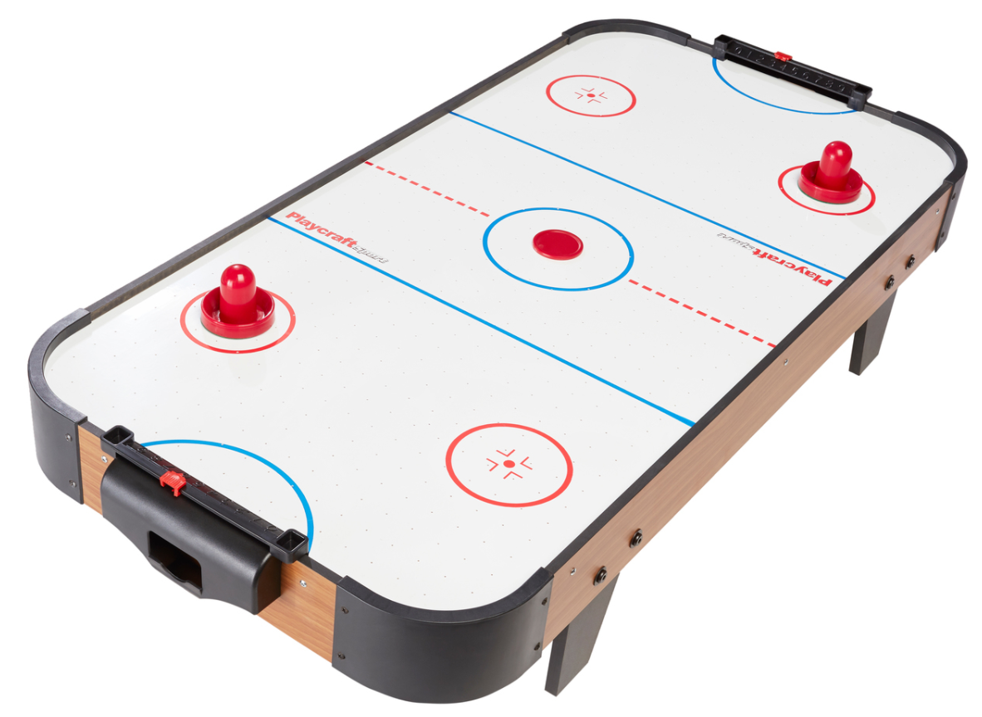
The IDEA

Slide 5
Explanation: The objects
Puck
Player
Wall
Field

Slide 6
Explanation: THE OBJECTS
Field
Movable
Player
Movable
Controlable
Puck
Wall
Design only
Not movable
Not controllable
100% resistance
Not controllable
0 friction

Slide 7
Explanation: THE PHYSICS
BALL
PLAYER
Void resetball()
Resets the ball in the center
Moves the ball in a random direction
Void update()
Updates the position of the ball based on is‘t velocity and it‘s speed
Void OnCollisionEnter()
Defines rules for the ball if it collides with another object
E.g. call resetball() in case of a goal
Void Update()
Updates the position of the player based on the physical input

Slide 8
EXpLANATION: AR AND ANimations
Vuforia
Imagetargets
AR Assets

Slide 9
The Outcome
<<A NICE VIDEO>>

Slide 10
Thank you very much for listening!
Are there any questions, commends or feedbacks?

